Slide 1



Investigating the transport of volatile-bearing vapors in the crust of the Moon
Angela N Tatsch, Jessica J Barnes
University of Arizona, Lunar & Planetary Laboratory
angelatatsch@arizona.edu
Arizona NASA Space Grant Consortium Student
Research Symposium | April 18, 2026
Si, P, Al, Cu, Fe, S
2.5µm

Slide 2
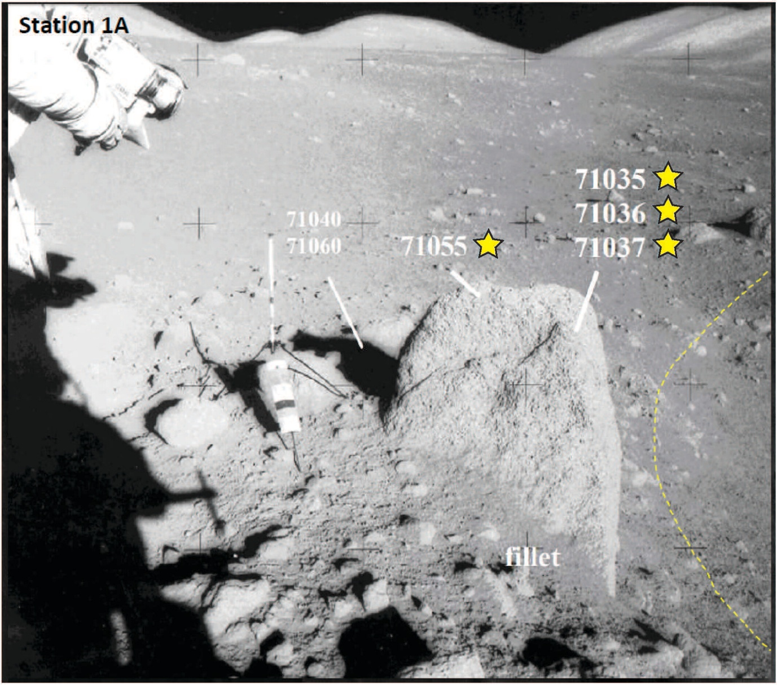
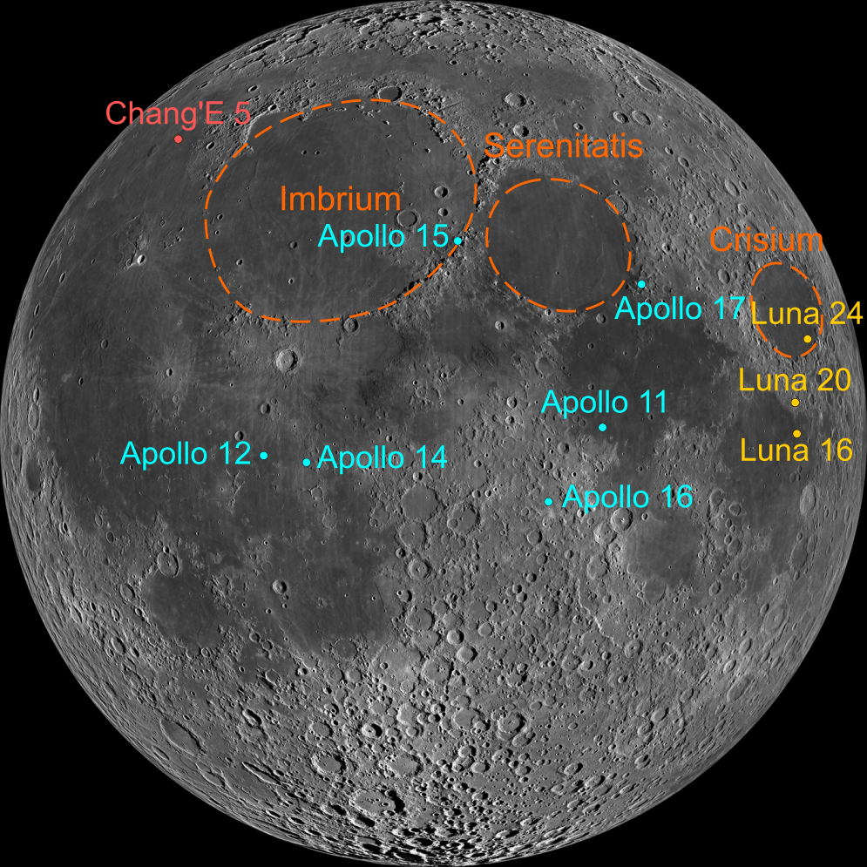
Background
Credit: NASA surface photo AS17-136-20739.
Apollo 17 landing site located on the edge of a basin filled with volcanics.
Rock sample collected from rim of Steno crater and returned to Earth for analysis.
credit: NASA/GSFC/ASU
Notes:
Add scale to fragment within presentation

Slide 3
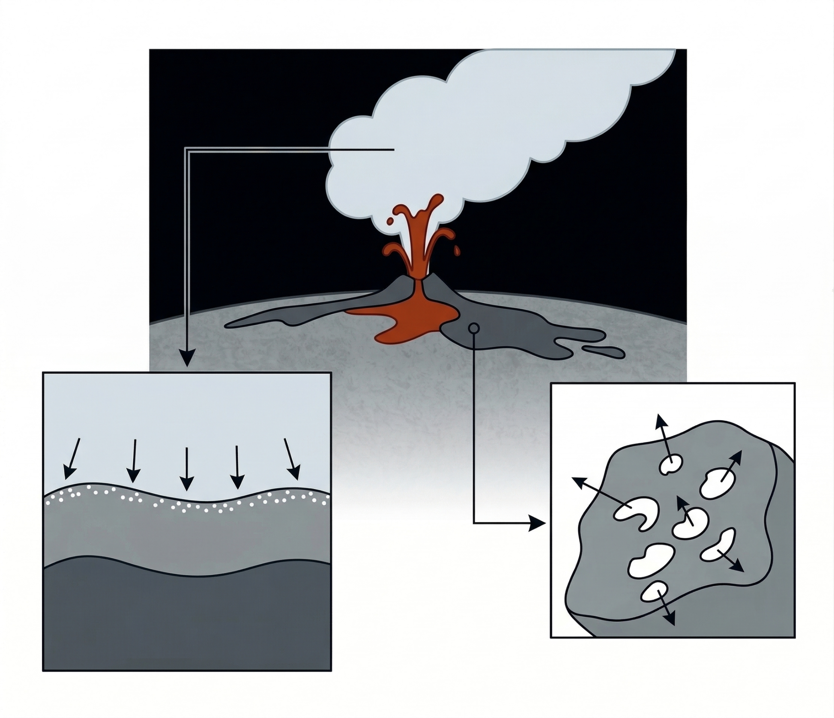
Significance
KCl
Volatiles = elements with low boiling points
Volcanic eruptions mobilize important elements (volatiles like H, S, Cu, Zn, Cl) as vapors within the lunar crust.
These elements may recondense to form phases on the lunar surface.
May explain unusual mineralogy, chemistry, and isotopic signatures in Apollo samples.
Constraining these processes is essential with upcoming lunar missions.
Vacuum
CuCl₂
H₂
H₂O
Vapor cloud
Lava flow
Voids = Escaped gases
Deposits of recondensed vapor
Image adapted from Google’s Gemini
Notes:
Volcanic eruptions produce volatile-rich gas clouds.
This process mobilizes important elements (volatile elements like H, S, Cu, Zn, Cl) as vapors within the lunar crust.
These elements may recondense to form phases on the lunar surface.
May explain unusual mineralogy, chemistry, and isotopic signatures in Apollo samples.
Constraining these processes is essential with upcoming lunar missions.

Slide 4
Methodology & Results
Goal: Identify and characterize potential vapor condensate deposits
Investigated a lunar volcanic sample (Apollo 17 mare basalt → 71055,25)
Located regions of interest near vesicles with Scanning Electron Microscope.

Slide 5
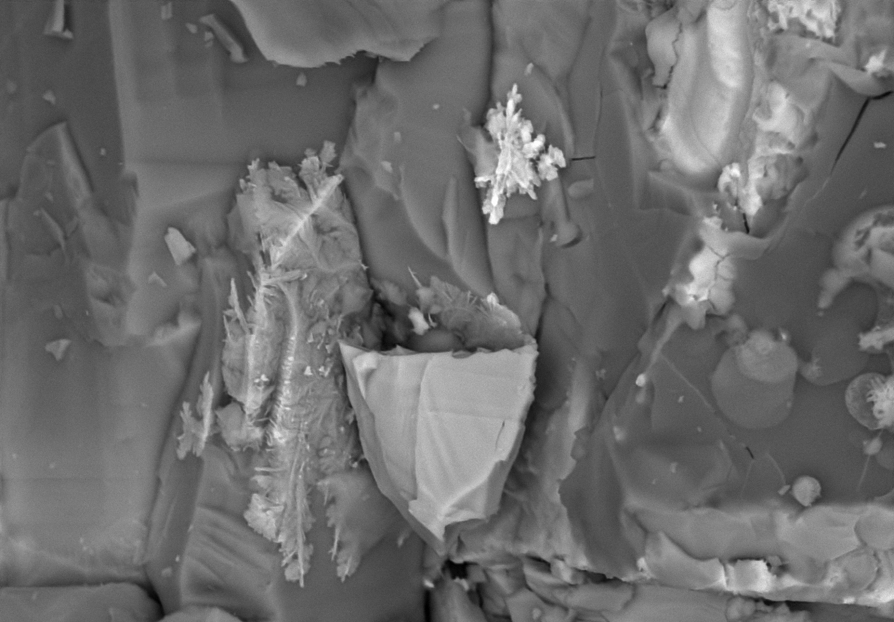
Methodology & Results
Goal: Identify and characterize potential vapor condensate deposits
Investigated a lunar volcanic sample (Apollo 17 mare basalt → 71055,25)
Located regions of interest near vesicles with Scanning Electron Microscope.
“Snowflakes”
Cu-rich,
vapor
deposit(?)
S
Back-scattered electron (BSE) image of bright, feather-like phase → potential vapor condensate deposit
Pl
P
Ilm
Px
P
30µm

Slide 6

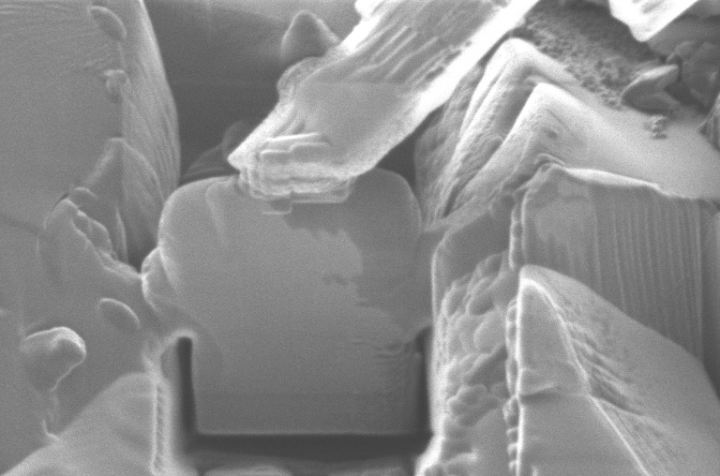
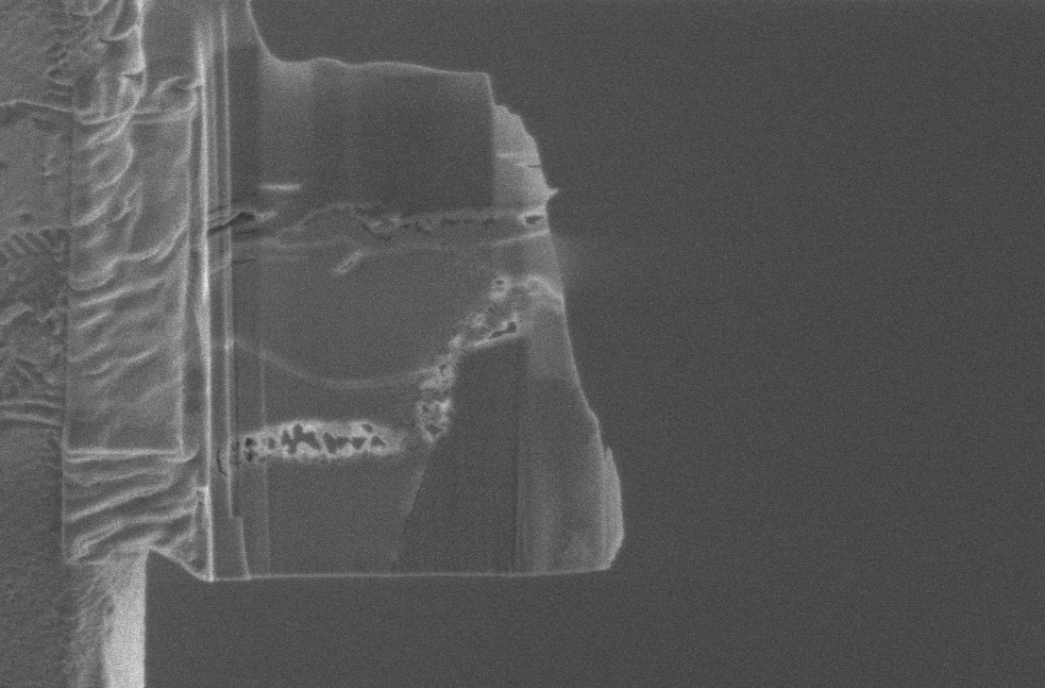
Methodology & Results: Section extraction with Focused Ion Beam
2D View, “Birds Eye View”
Tilted ~50°
Tilted 90° from “Birds Eye View”
30µm
5µm
5µm

Slide 7

Methodology & Results: Transmission Electron Microscopy
Cu sulfide, possibly digenite (Cu₉S₅)
A1
Record diffraction patterns → identify minerals using atomic structure
Software used includes CRISP and DigitialMicrograph
Anorthite
Fe-Ni metal
Lattice spacing from A1, showing atomic structure of mineral. Identified as digenite (d-spacing ~0.202 nm).
Fe-S
Si, P, Al, Cu, Fe, S
5nm
2.5µm

Slide 8
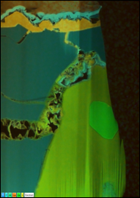
Results & Discussion
Complex vein structures with
Cu-S (orange-yellow) and P
(neon blue) signatures
Indicates lunar origin
(not contamination)
Supports the condensation origin
Cu-S
Cu-S
An
Fe-Ni
Fe-S
Fe-S
Si, P, Al, Cu, Fe, S
1µm
Si, P, Al, Cu, Fe, S
Si, P, Al, Cu, Fe, S
1µm
2.5µm

Slide 9
Discussion
Only one other report: lunar regolith (soil) sample has recently identified a similar digenite deposit, relating to different lunar processes (Lui et al., 2024).
We are also investigating how heating from meteorite impacts may remobilize volatile elements using Apollo 14 regolith breccias.
Identified potential vapor condensate deposit near vesicle with bright, feather-like texture within Apollo 17 mare basalt 71055,25.
Cu-S signatures within veins indicate a lunar origin.
Heating from volcanic eruptions mobilized volatile elements as vapors and condensed to form these deposits within the lunar crust.
Conclusions
Si, P, Al, Cu, Fe, S
2.5µm
Notes:
Compare to recent findings; have volcano image on last slide instead?

Slide 10


Acknowledgments
A special thank you to my mentor Dr. Jessica Barnes, Iunn Ong, Kana Ishimaru, Callista Madej, Dr. Zoe Wilbur, Zoe Zeszut, Dr. Jerry Chang, Michelle Coe, and the AZSGC.
The material contained in this document is based upon work supported by a National Aeronautics and Space Administration (NASA) cooperative agreement 80NSSC25M7084. Any opinions, findings, conclusions or recommendations expressed in this material are those of the author and do not necessarily reflect the views of NASA. This work was supported through a NASA grant awarded to the Arizona/NASA Space Grant Consortium.
Contact me
angelatatsch@arizona.edu | linkedin.com/in/angela-tatsch/
Notes:
Michelle recommends separate slide for Thank you

Slide 11
Acknowledgments
Thank you!
A special thank you to my mentor Dr. Jessica Barnes, Iunn Ong, Kana Ishimaru, Callista Madej, Dr. Zoe Wilbur, Zoe Zeszut, Dr. Jerry Chang, Michelle Coe, and the AZSGC.
The material contained in this document is based upon work supported by a National Aeronautics and Space Administration (NASA) cooperative agreement 80NSSC25M7084. Any opinions, findings, conclusions or recommendations expressed in this material are those of the author and do not necessarily reflect the views of NASA. This work was supported through a NASA grant awarded to the Arizona/NASA Space Grant Consortium.
Contact me
angelatatsch@arizona.edu | linkedin.com/in/angela-tatsch/
Notes:
Michelle recommends separate slide for Thank you

